Slide 1
SQL Test Case Generation Using Multi-Objective Optimization
20184228 Seah Kim
20184400 Jeonggwan Lee
20186473 Liu Lingjun
20186505 Nick Heppert

Slide 2
Table of Contents
Introduction of motivated paper
Our challenge
Our goal and expectation

Slide 3

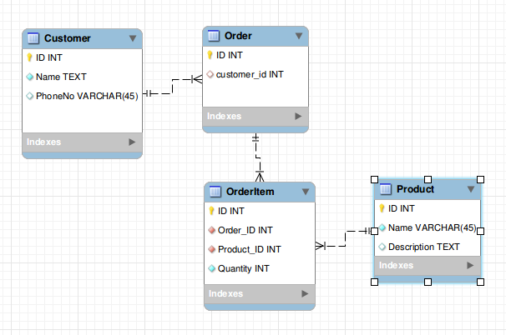
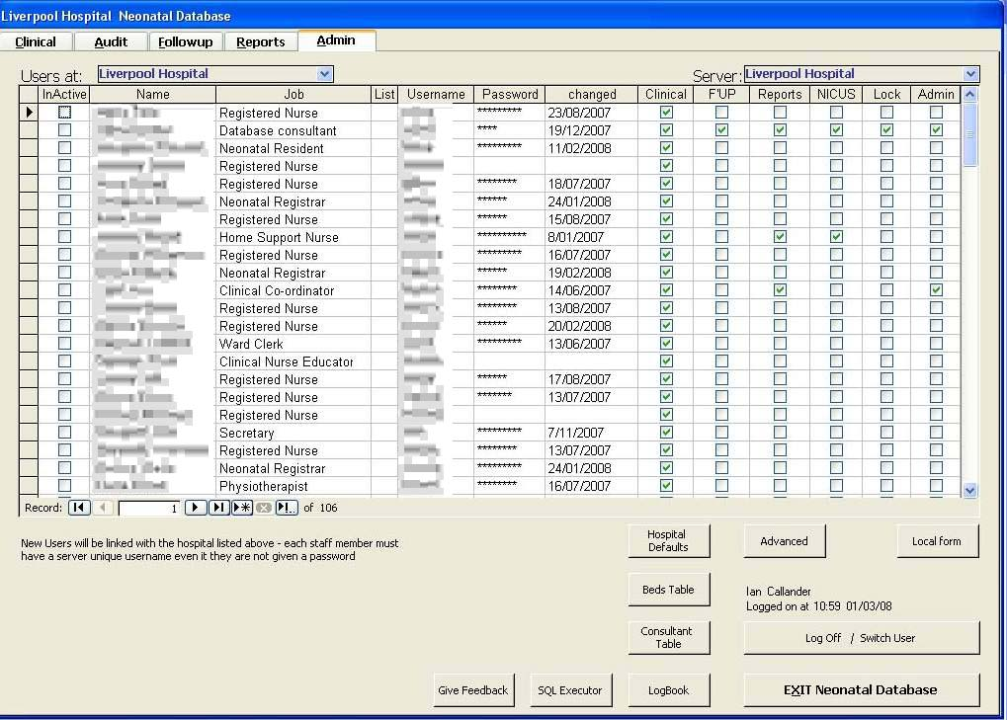
SQL is everywhere!
Database-centric systems strongly rely on SQL Queries to manage and manipulate their data.
Accounting, Customer management, Medical Information etc.

Slide 4
SELECT items .* FROM invoice JOIN items ON invoice.id = items.invoiceid WHERE amount > 1000 OR taxFree = true
How should we test this query?
Notes:
Add more slides for SQL usages

Slide 5
Search-based Test Data Generation for SQL Queries
Jeroen Castelein et al. ICSE 18’

Slide 6
Search-based Test Data Generation for SQL Queries
(Jeroen Castelein et al. ICSE 18’)
Modeled the problem of test data generation for SQL queries as a search-based problem.
Implemented three different search approaches in tool, named EvoSQL (random search, biased random search, genetic algorithms)
Executed on 2,135 queries extracted from 4 software systems
Castelein, Jeroen, et al. "Search-based test data generation for SQL queries." Proceedings of the 40th International Conference on Software Engineering. ACM, 2018.

Slide 7
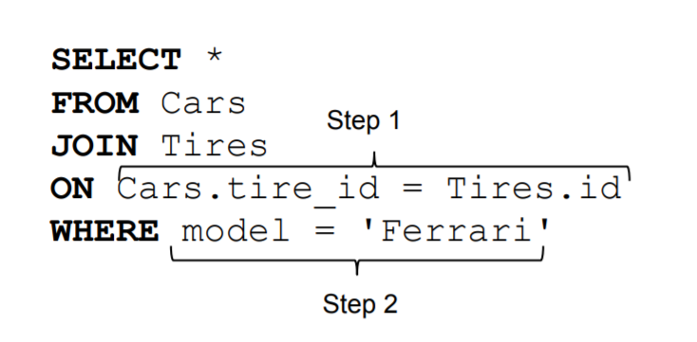
Fitness Function
If Step 1 doesn’t produce an output, database stops its execution before proceeding to Step 2
Castelein, Jeroen, et al. "Search-based test data generation for SQL queries." Proceedings of the 40th International Conference on Software Engineering. ACM, 2018.
Notes:
The concept of this fitness function is that each step of the query are executed when the former step has been executed

Slide 8
Fitness Function
whole steps for a coverage target
…
…
step level
operations,
such as comparison, logical,
sql operators
step distance
steps such as JOIN, WHERE
Fitness function = step level + step distance
Notes:
The concept of this fitness function is that each step of the query are executed when the former step has been executed

Slide 9
Problem: Inefficiency of single-target strategy
1. The order of each coverage target is not optimized
2. Inefficient allocation of the budget might happen, such as infeasible coverage target.

Slide 10
Solution
Multi-Objective Optimization!

Slide 11
Multi-Objective Optimization
SELECT * FROM Product WHERE (Category = ‘Toy’ )

Slide 12
Multi-Objective Optimization
id | category
1 | Toy
2 | Food
3 | Car
SELECT * FROM Product WHERE (Category = ‘Toy’ )
Product

Slide 13
Multi-Objective Optimization
id | category
1 | Toy
2 | Food
3 | Car
SELECT * FROM Product WHERE (Category != ‘Toy’ )
Product

Slide 14
Multi-Objective Optimization
Challenge 1. The order of each coverage target being executed is not optimized
…
Target 1
Target 2
Target 3
Target n
GA
GA
GA
GA

Slide 15
Multi-Objective Optimization
Challenge 1. The order of each coverage target being executed is not optimized
…
Target 1
Target 2
Target 3
Target n
GA

Slide 16

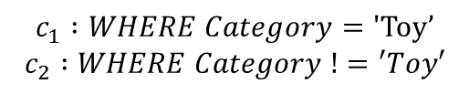


Multi-Objective Optimization
SELECT * FROM Product WHERE (Category = ‘Toy’ )
id | category
1 | Toy
id | category
1 | Toy
2 | car
$${f(c}_{1})$$
$$\left\{\begin{aligned}\min{}f(c_{1}, t) \\ \min{}f(c_{2},t)\end{aligned}\right.$$
$$c_{1} :WHERE Category=\text{'}\text{Toy}’$$
$$c_{2} :WHERE Category !=′Toy′$$
id | category
2 | car
$${f(c}_{2})$$

Slide 17
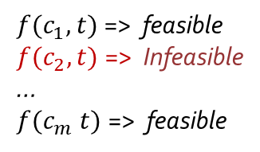

Multi-Objective Optimization
Challenge 2. Inefficient allocation of the budget might happen, such as infeasible coverage target.
“A > 10 and A < 10”? → infeasible, no solution from GA
$$\left\{\begin{aligned}\min{}f(c_{1}, t) \\ \min{}f(c_{2}, t) \\ … \\ \min{}f(c_{m},t)\end{aligned}\right.$$
$f(c_{1}, t)$=> feasible
$f(c_{2}, t)$=> Infeasible
…
$f(c_{m} t)$=> feasible
Solution from EvoSQL is to manually remove infeasible coverage targets.

Slide 18
Our Expectation
Our MOO version can solve more complex queries simultaneously compared to single-objective strategy.
Each solution is guided by hinting the similar solution from other coverage target.
It doesn’t consume improper budget for handling the infeasible coverage target .

Slide 19
Questions?
Thanks for your attention!

Slide 20
Fitness Function
Satisfying coverage target means solution T yields a non-empty result. ( T = {T1, …, Tn} : set of tables )
If T does not cover the given target, measure the distance of T to cover the target
Counting the number of yet unsatisfied steps (step level)
Measuring how far T is to satisfy the step where execution stopped (step distance)
Castelein, Jeroen, et al. "Search-based test data generation for SQL queries." Proceedings of the 40th International Conference on Software Engineering. ACM, 2018.
Notes:
The concept of this fitness function is that each step of the query are executed when the former step has been executed

Slide 21
Genetic Algorithm
For single coverage target from a query, implement standard GA(with Crossover, Mutation).
Using seeding strategies, it uses a seeding pool containing all constants appearing in the query.
Post Processing for readability of the generating data.
There are three approaches, Random Search, Biased Random Search(seeding strategy) and, GA.
Notes:
The concept of this fitness function is that each step of the query are executed when the former step has been executed

Slide 22
What can we develop?

Slide 23
Inefficiency of GA in EvoSQL
calculating the fitnesses & applying the search operators

Slide 24
Inefficiency of GA in EvoSQL
calculating the fitnesses & applying the search operators
Re-executed multiple times, once for each coverage target

Slide 25
Problem Let R = {r1, …, rm} be the set of coverage targets for a query Q according to a coverage criterion. Find test data S that satisfies all coverage targets in R.
Notes:
Need to explain coverage criterion?

Slide 26
Solution T = {T1, …, Tn} : set of tables each table Ti = {R1, …, Rk} : composed of rows each row Rj = {V1, …, Vc} (c = number of columns in Ti)

Slide 27
Fitness Function
Distance
Operations required to process the query and the order by which they needed to be performed
Function
Operations required to process the query and the order by which they needed to be performed

Slide 28
Testing SQL Queries
Database-centric systems strongly rely on SQL Queries to manage and manipulate their data.
How developers test SQL queries? => Actually, they need to create test data by hand. But, this can be challenging and time-consuming for complex queries.

